Slide 1
Circuitpython ML and plan for today
Dexter R. Shepherd

Slide 2
Recap
We have built circuit python data logging devices
Python knowledge should be getting stronger

Slide 3
Contents
Deploying machine learning on devices (for interest)
Smart sensors (constructing custom sensors)
IoT
Plan of action for today
The ML models we are covering we will cover in more detail next week - you can treat them as a black box today

Slide 4
Circuitpython ML

Slide 5
Machine learning simple
We will cover algorithms more in depth, but for now let’s look at these definitions
Regression
Classification

Slide 6
Regression
Predicting a scale
Can be thought of as finding a line of best fit
Classification
Finite number of options
Can be thought of as working out a relationship between data and a set amount of options

Slide 7
For two variables
Image we are looking at how the amount of water given to a plant each day improves growth
Let’s pretend this is our data
Height
Water

Slide 8
For two variables
Image we are looking at how the amount of water given to a plant each day improves growth
Let’s pretend this is our data
We have a line of best fit!
y=mc+c
Height
Water

Slide 9
Memory of this line
In terms of memory, our regression model has a gradient and intercept (two float values)
30 bits per float on a circuit python device
60 bits used
Available on the Pico: 264 kilobytes (KB) (2.112e+6 bits)

Slide 10
Multi-linear regression
Even with multi linear regression our models still can store a number of variables. Up to about 70,400 variables.

Slide 11
How about for deep learning?
Neural networks take up much more memory than regression models

Slide 12
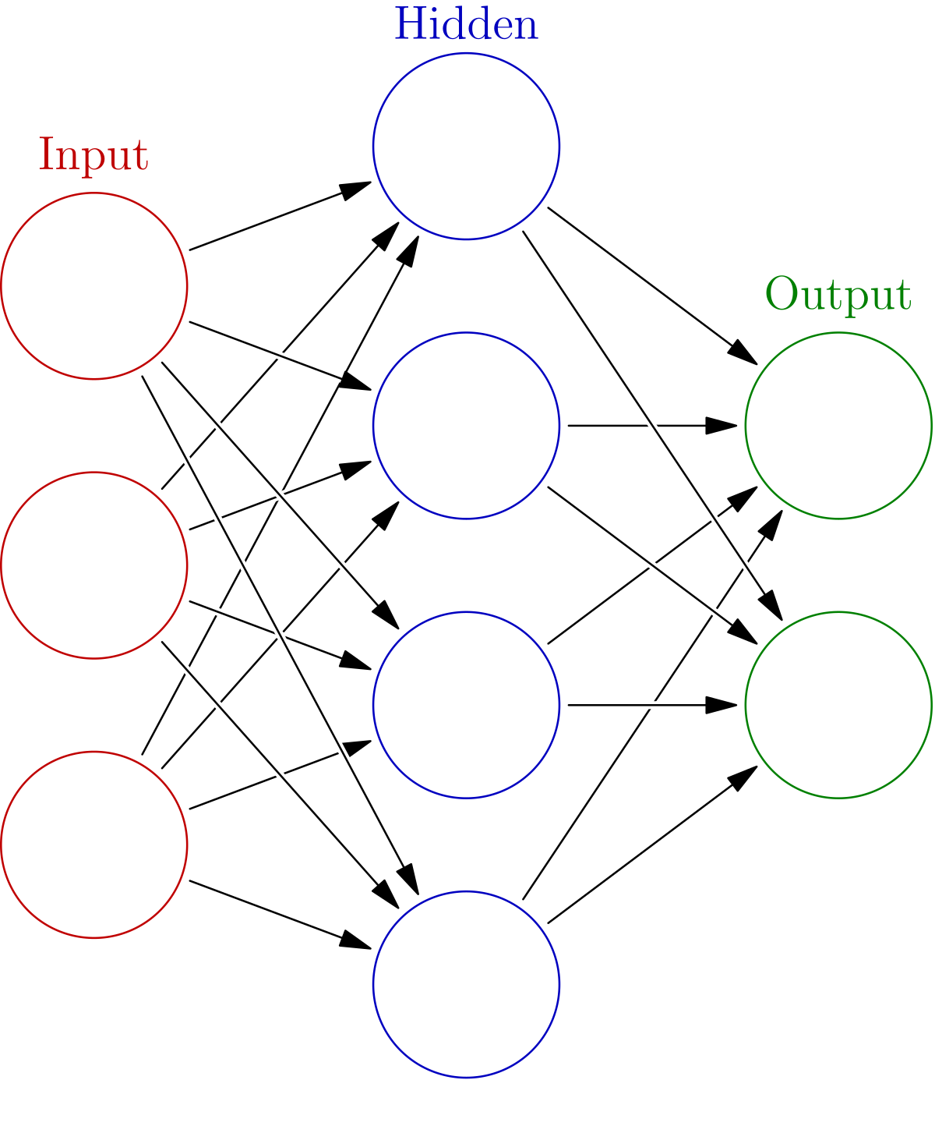
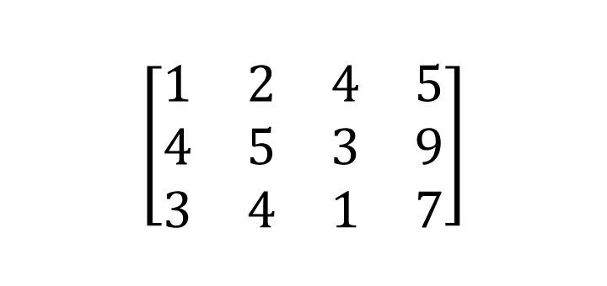
Neural networks (Simple)
Neural networks are stored as matrices

Slide 13
Memory of this neural network
3 x 4 floats + 4 x 2 floats
= 12*30 + 8*30 = 600 bits

Slide 14
But what if we had an image
An image contains far more values once flattened
Lets say our image of 100 x 100 pixels is flattened into a linear layer of 10,000 - we already need 300,000 bits for the data (37.5 KB/264 KB)
The next layer contains 10,000 x H. Lets say H is 100, we then need 1,000,000 bits! (125 KB + 37.5 KB / 264 KB)
Then let’s add an output layer of 10 (let’s imagine we are classifying something) then we have 100 x 10 = 1000 bits (0.125 KB+ 125 KB + 37.5 KB / 264 KB)

Slide 15
Images on NN in CP
It is technically possible!
But remember your program itself will take up memory with variables - as well the speed of reading the camera and compressing the input to 100 x 100 might be quite time consuming

Slide 16
Why use embedded ML

Slide 17
Datalogging
Regression models for sensor calibration is not uncommon, for example calibrating the analogue read from a pressure sensor to correspond to kg.
In datalogging you tend not to use this, you want raw values and then you do any post processing later (as to not lose accuracy)

Slide 18
Taking action
A better use is outside of data logging, something that uses existing data to make decisions.
Perhaps if crops get too dry or specific diseases are detected using sensors, it uses a model to classify this and alert someone (or deal with the problem itself)

Slide 19
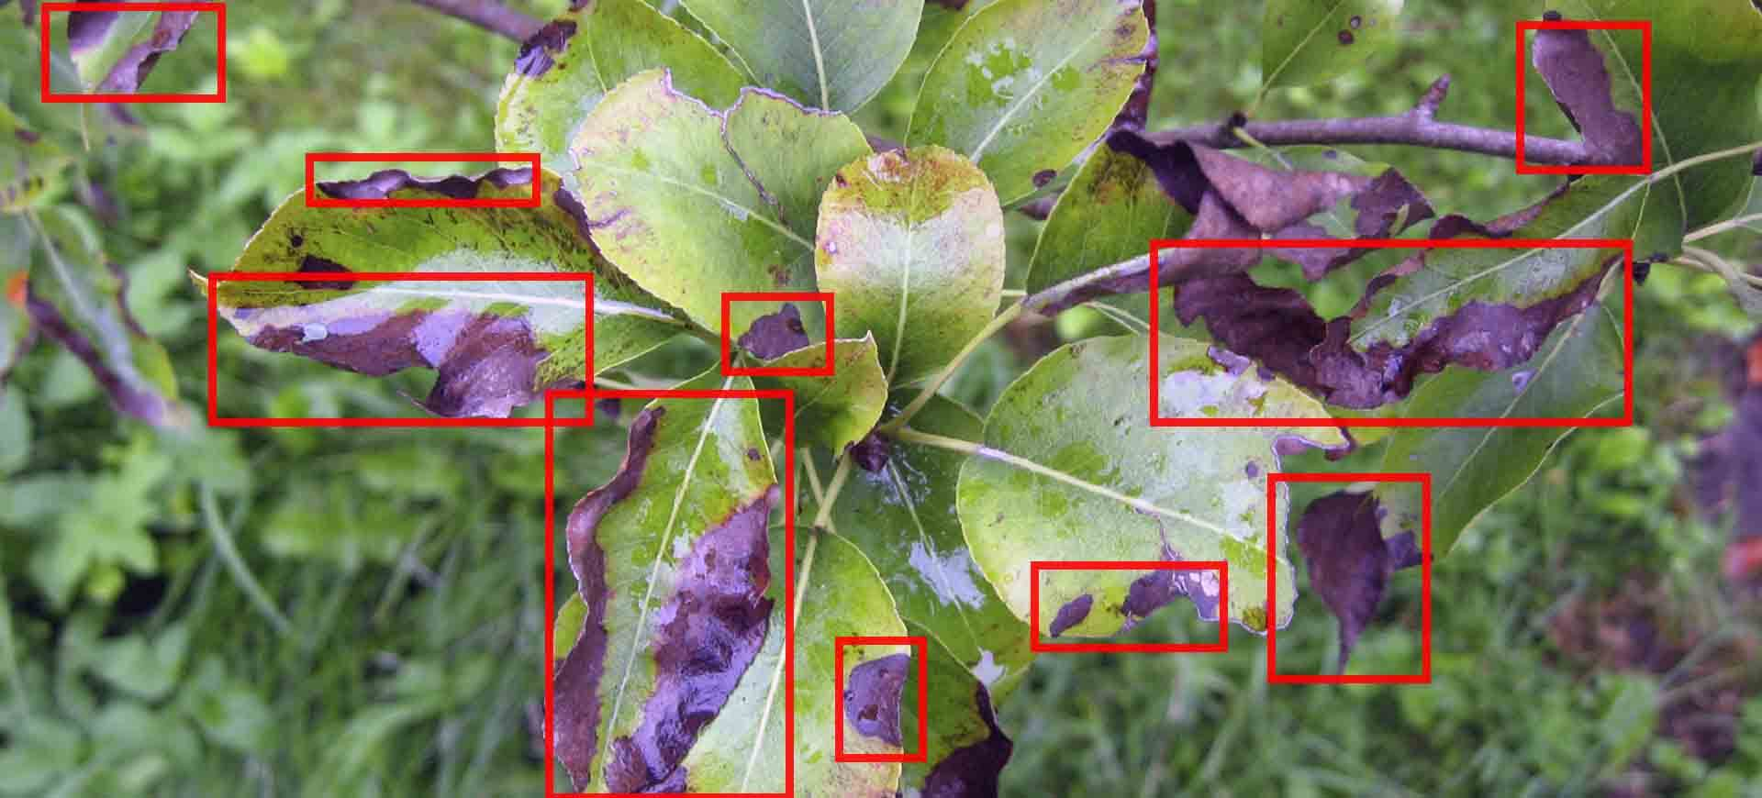
Disease detection
https://bitrefine.group/industries/precision-agriculture/88-industries/agriculture-food/agriculture-solutions/184-plant-disease-detection

Slide 20
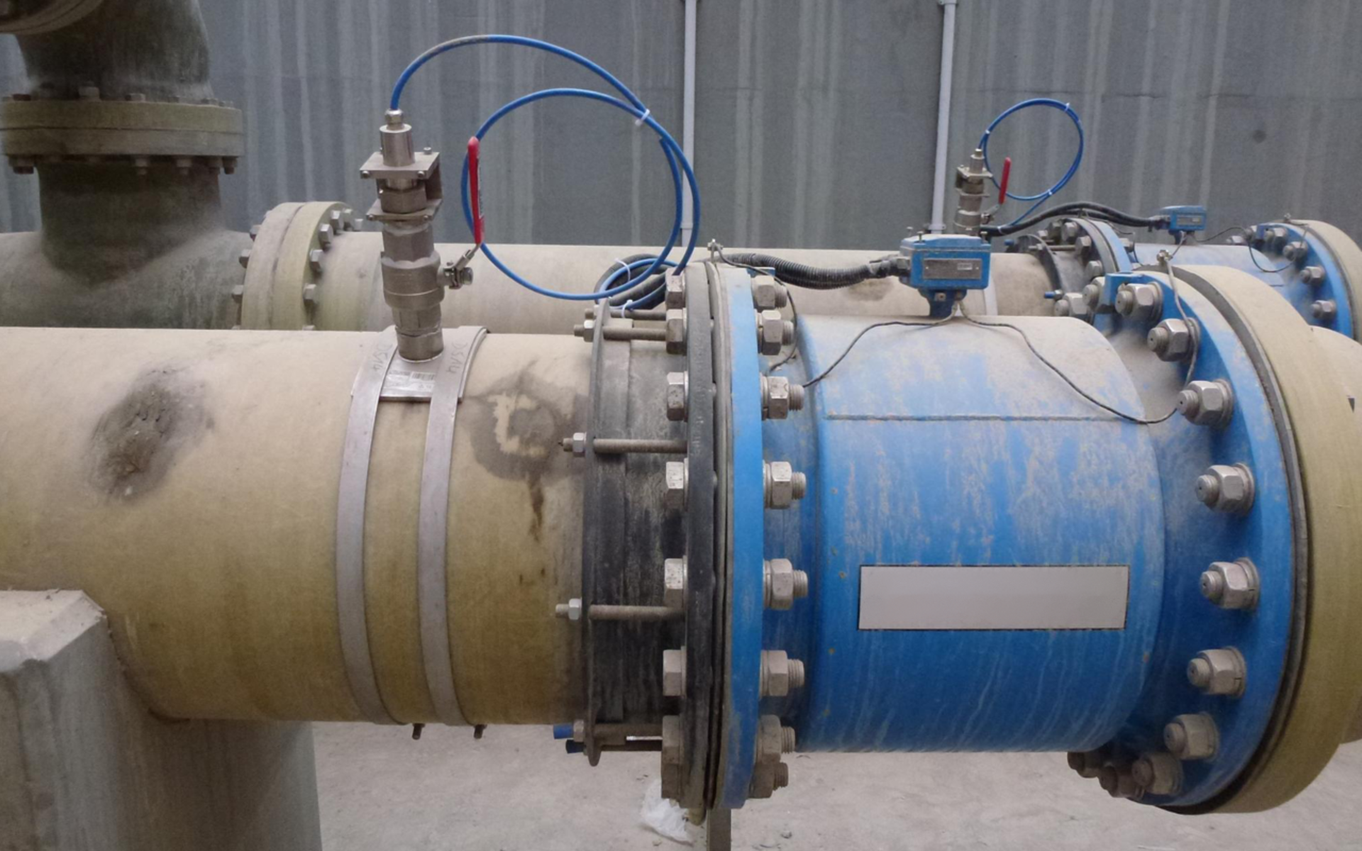
Pipe pressure sensing
Notes:
Regression to make values readable

Slide 21
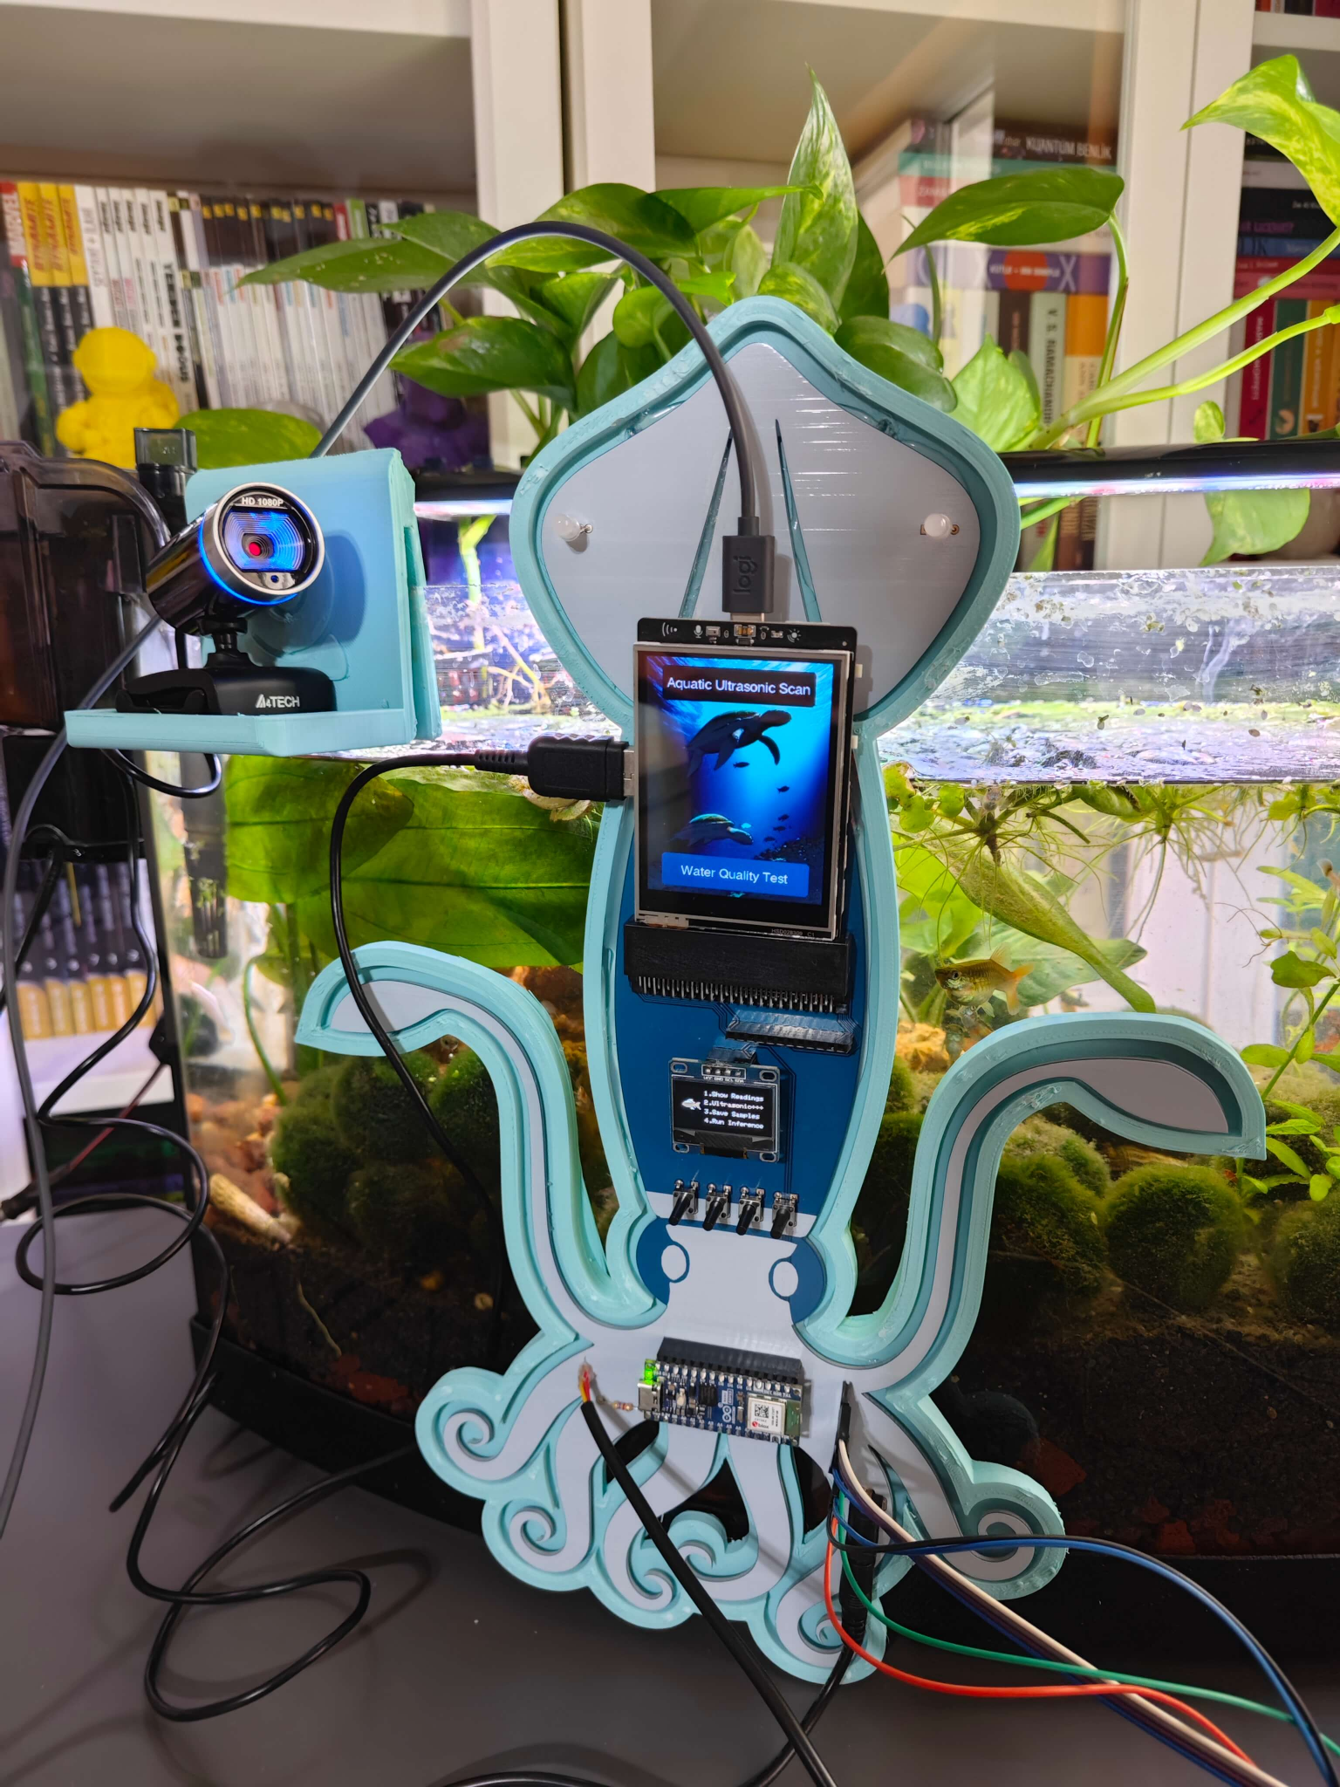
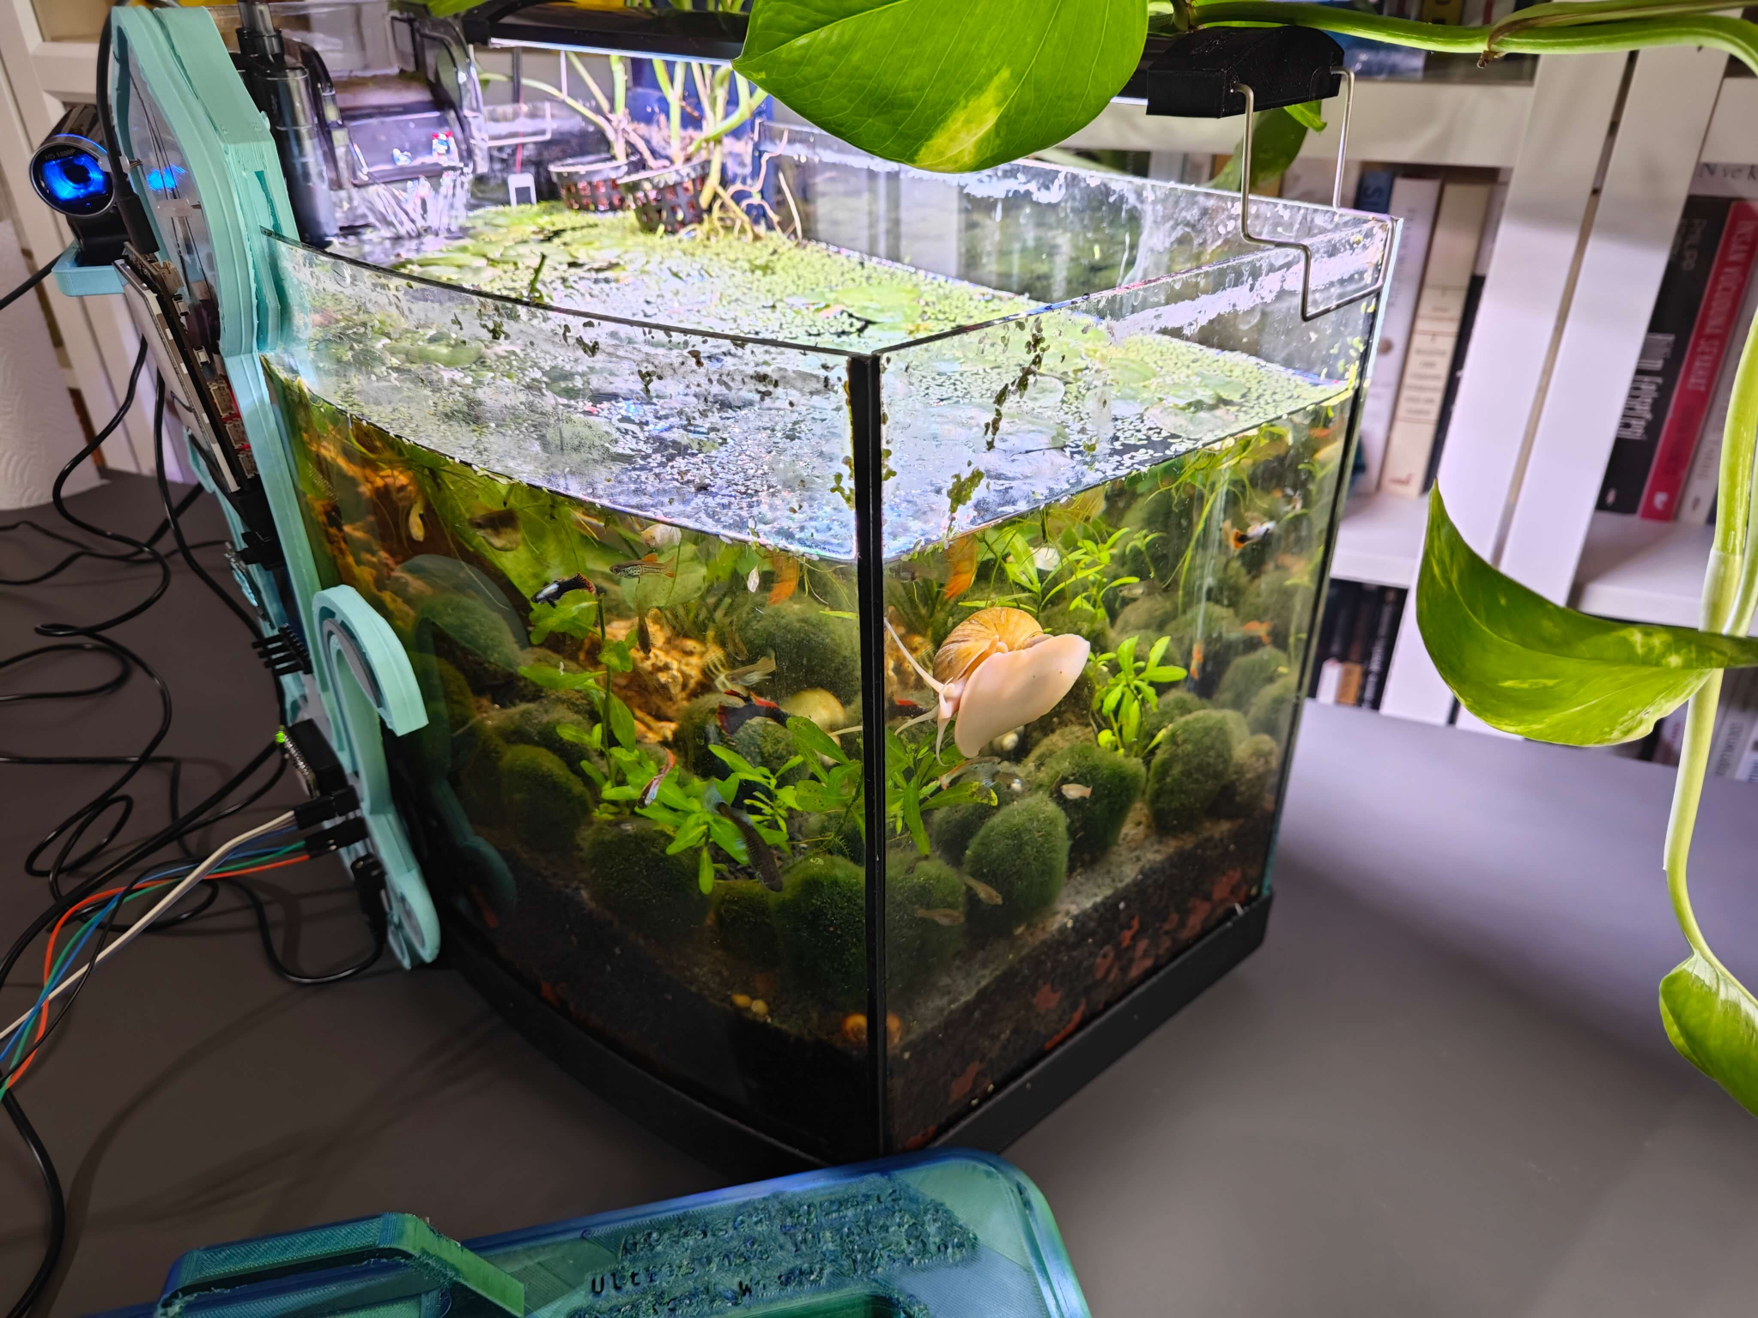
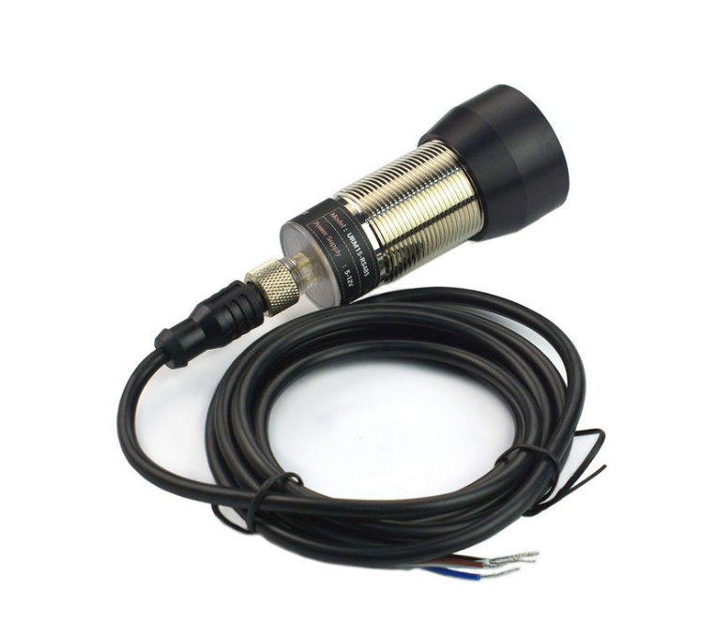
Fish tank automation
https://community.dfrobot.com/makelog-314279.html
Notes:
Assessing water pollution using ultrasonic scanning of the tank - used a neural network

Slide 22
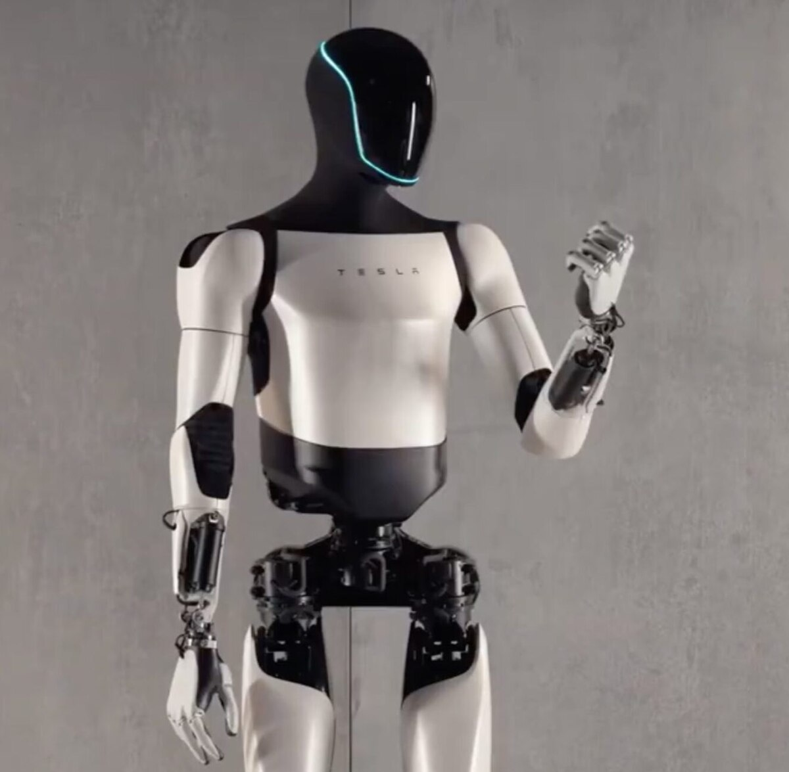
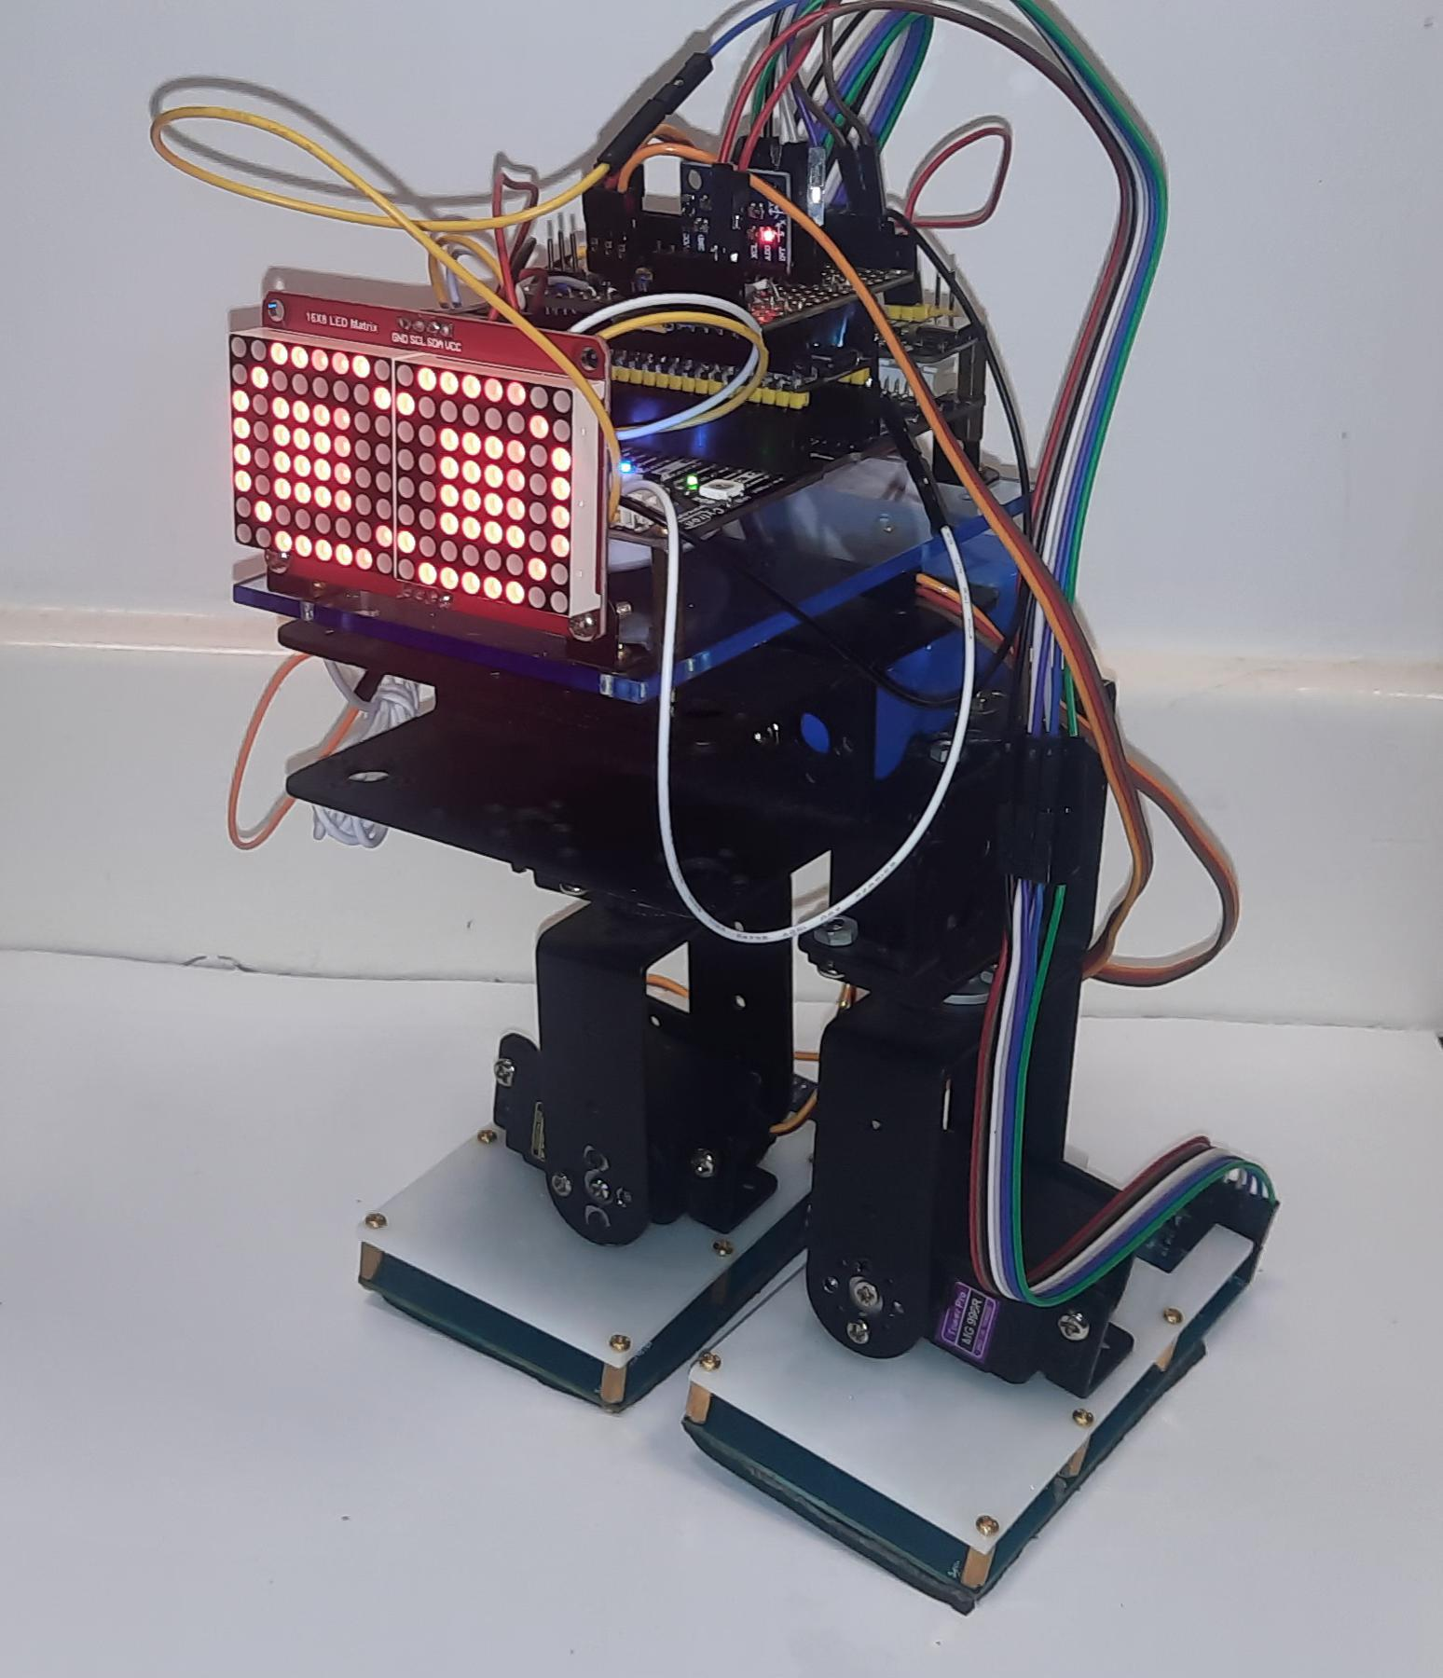
Robotics
It’s not always possible to use simple devices
But can be very useful for offloading repetitive tasks

Slide 23
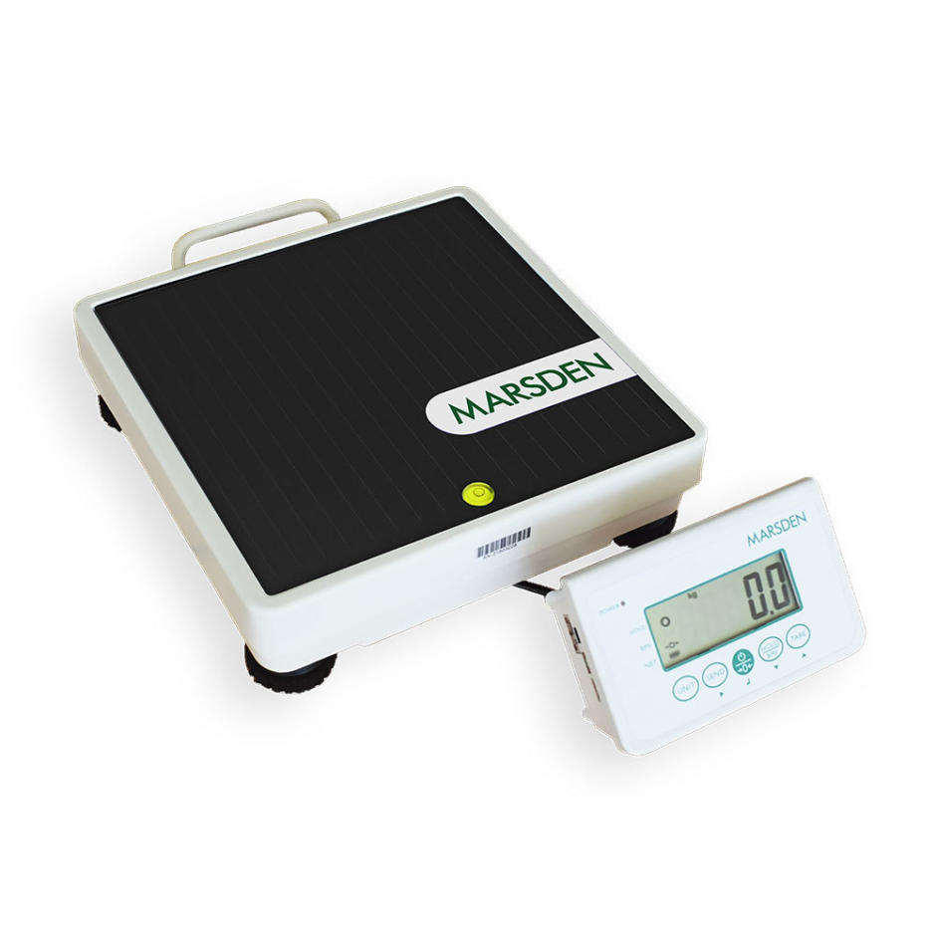
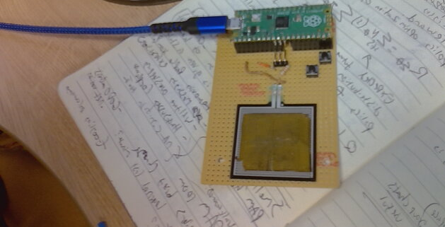
Making scientific equipment

Slide 24
Making custom sensors

Slide 25
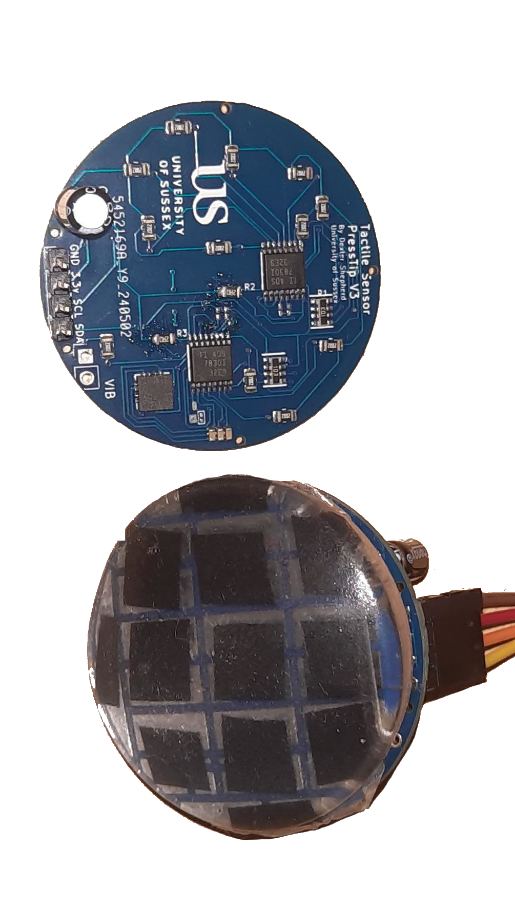
You are not confined to one sensor!
Consider using similar sensors to validate each other (piezoelectric and accelerometer for more accurate vibrations).
Consider completely different sensors to find a relationship between something (temperature and humidity for weather prediction).

Slide 26
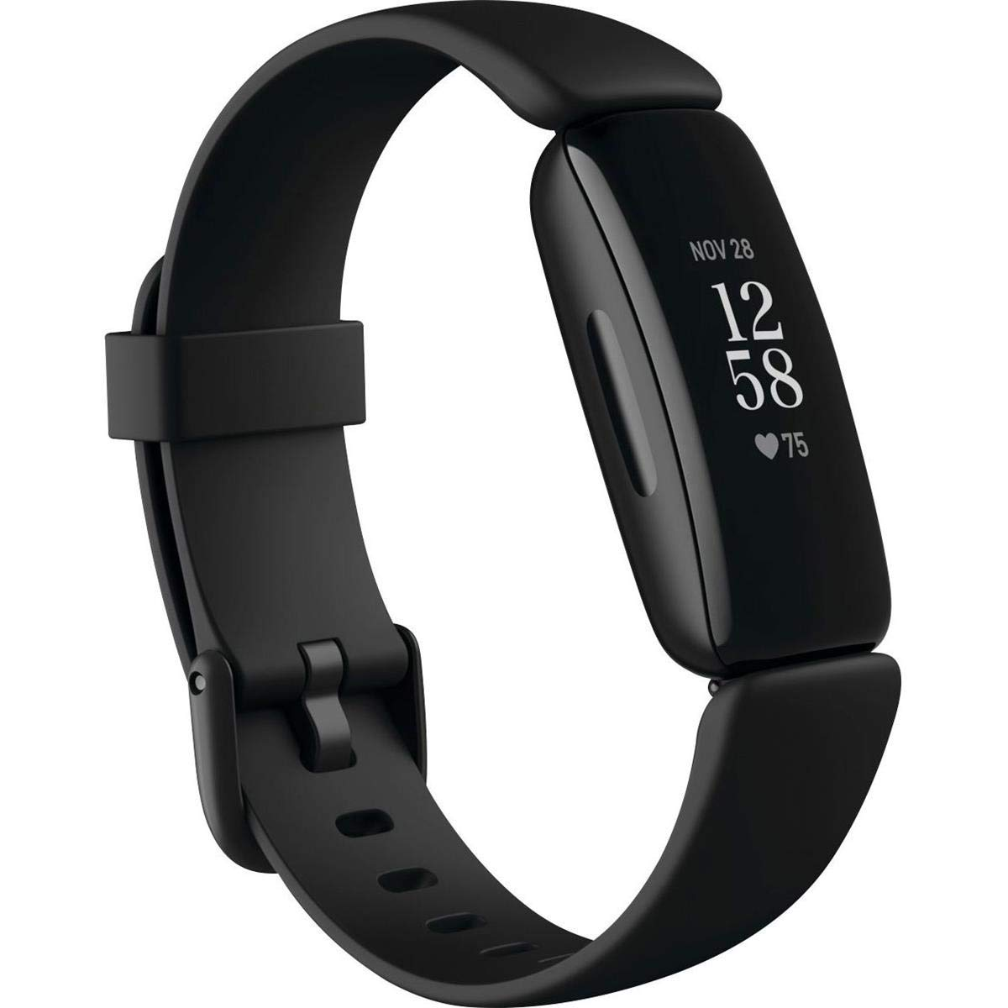
Example
Fitbits detects your movement and heart rate to monitor your sleep
Heart rate alone does not tell you, neither does movement alone.
Together the sensor can detect these behaviours.

Slide 27
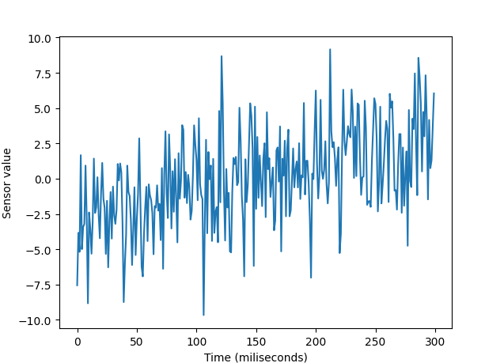
From a model point of view
One channel signal can be concatenated into temporal windows… or simply use a model that allows for temporality (LSTM)
Time —>

Slide 28
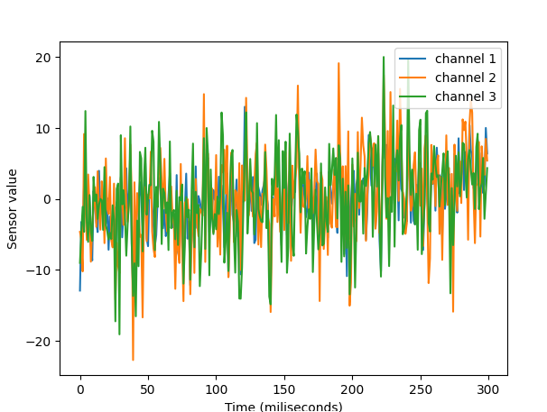
From a model point of view
Multiple channel model is no different… it’s just more channels
Can be a single vector
(or temporal vector)
Time —>

Slide 29
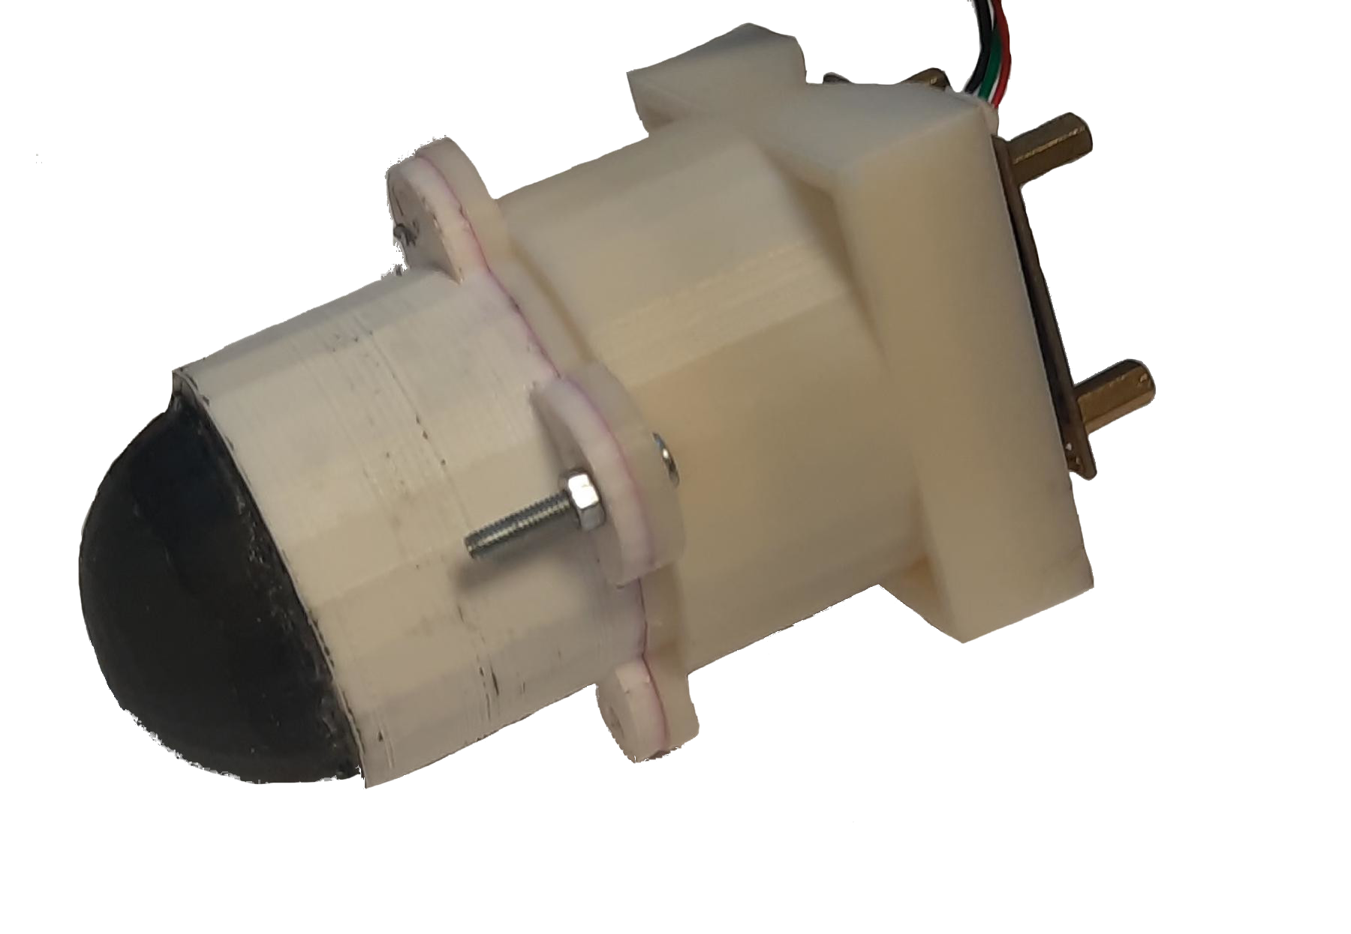
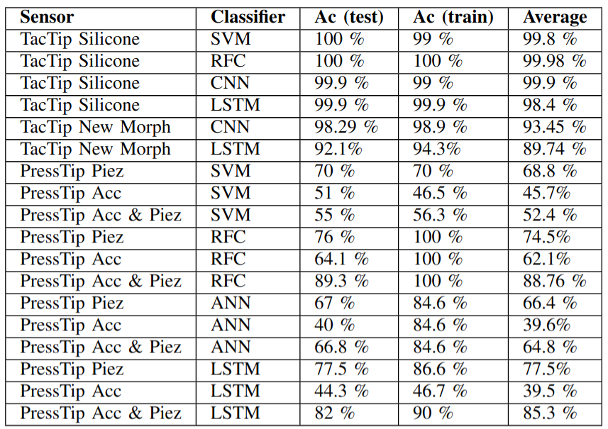
This can sometimes lead to better accuracy

Slide 30
Internet of Things

Slide 31
What is IoT
A network of physical objects—"things"—equipped with sensors, software, and other technologies, enabling them to connect and exchange data with other devices

Slide 32
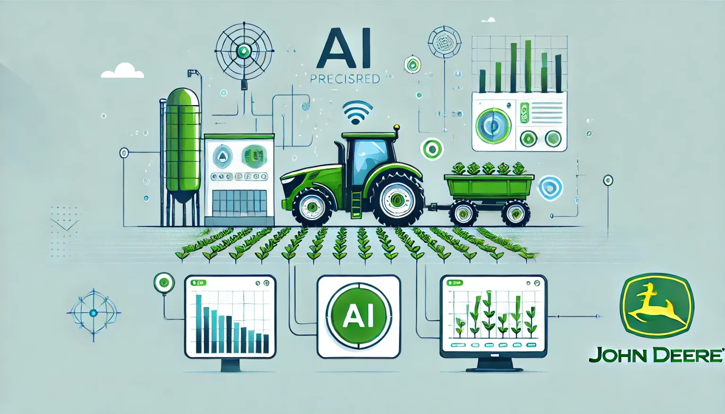
Example
Smart Agriculture Monitoring
Soil moisture, temperature, humidity, and light sensors connected to an ESP32 or Raspberry Pi Pico W.
Store sensor data over time to analyze environmental trends.
https://redresscompliance.com/top-15-real-life-use-cases-for-ai-in-agriculture-industry/

Slide 33
Example
AI-Enhanced Weather Station
Sensors for temperature, humidity, air pressure, and wind speed.
Collect long-term climate patterns.
https://agrinextcon.com/how-iot-ai-are-transforming-smart-farming/

Slide 34
Example
Smart Livestock Monitoring
Wearable sensors (temperature, motion, heart rate) for cows or goats using an ESP32 with Bluetooth or LoRa.
Track movement, activity levels, and health indicators.
https://redresscompliance.com/top-15-real-life-use-cases-for-ai-in-agriculture-industry/

Slide 35
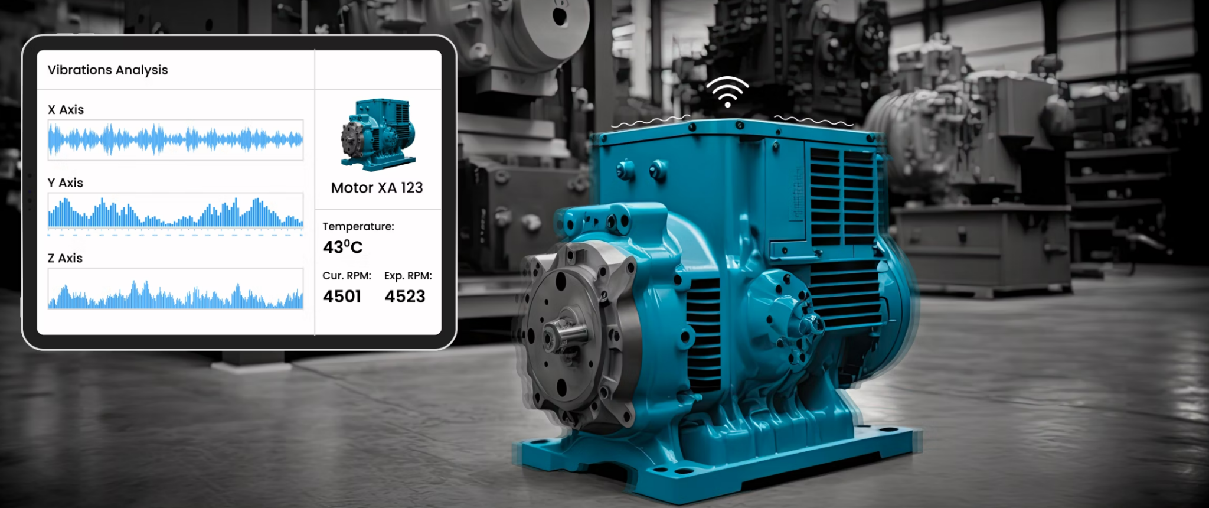
Example
Vibration-Based Equipment Monitoring
Attach a piezoelectric sensor to a machine to log vibrations.
Analyze frequency and amplitude of vibrations.
Predict equipment failures using anomaly detection.
https://www.intuz.com/blog/industrial-iot-solution-use-case-for-equipment-vibration?

Slide 36
Why IoT
These examples demonstrate how IoT and AI technologies are being applied across various industries to monitor conditions, predict issues, and optimize operations.
It allows real time monitoring and remote data collection

Slide 37
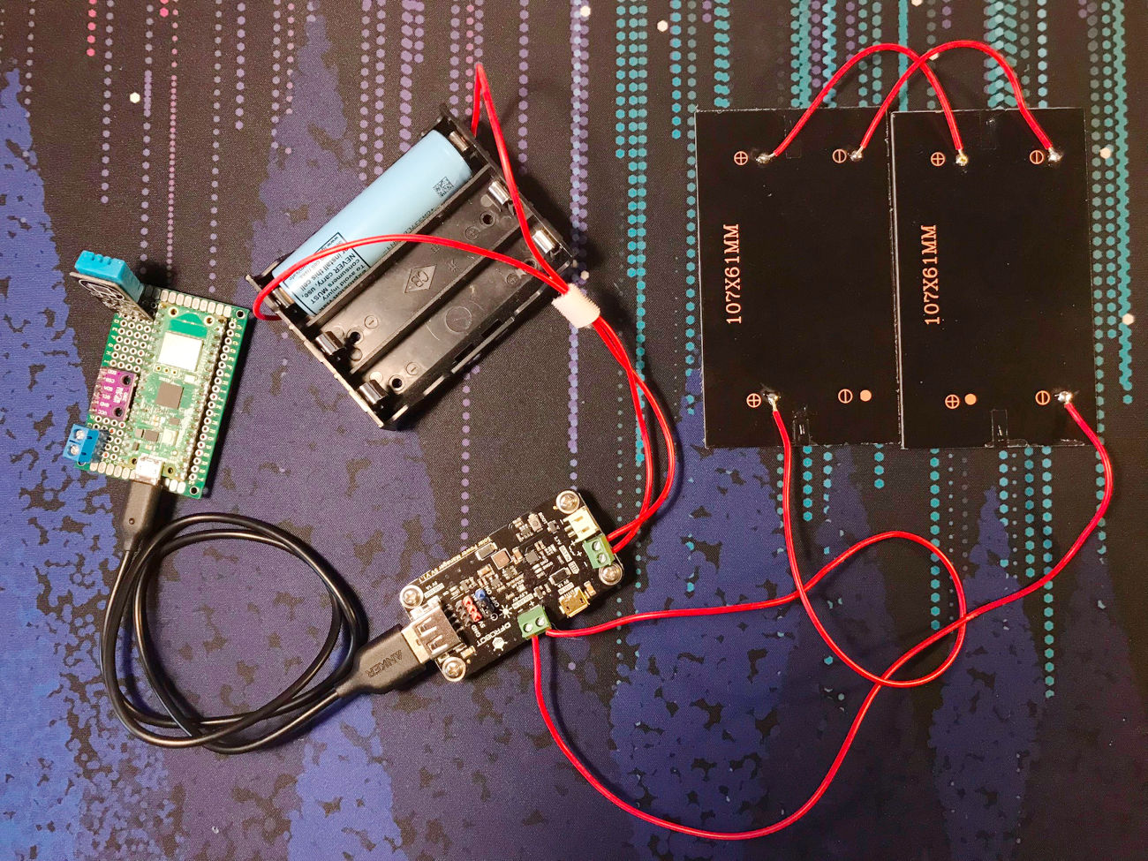
Devices left remotely
Will need power!
Solar
+ long term
- expensive
Mains supply
+ long term
- not always available
Battery
+ cheaper
- does not last as long

Slide 38
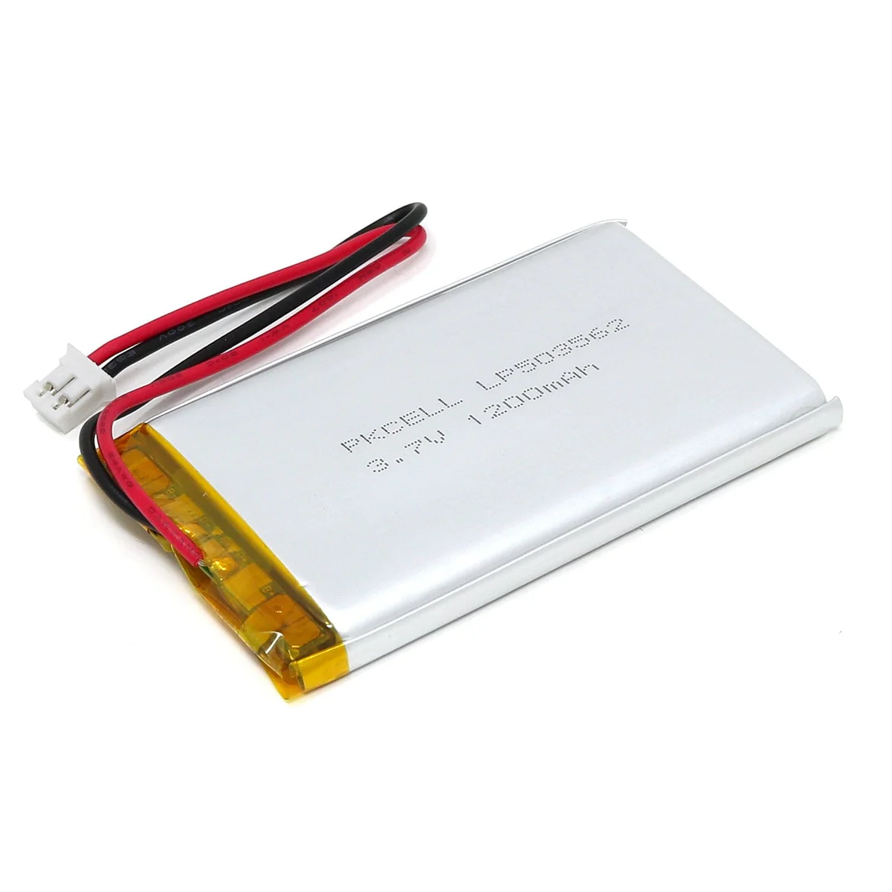
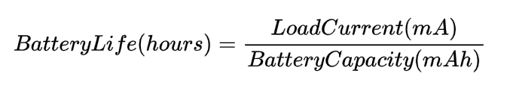
Battery technology
We can calculate how long a battery will last
The battery capacity is on the
datasheet for your battery
Equally we can calculate the current draw using a multimeter

Slide 39
Example
Raspberry Pi Pico <- 50–100 mA
Humidity Sensor <- 2.5 mA
SD Card write <- 50–100 mA
Worst case scenario 100+2.5+100 = 202.5 mA
Battery = 1200 mAh
Total_time = 1200/202 = 5.94 hours
Best case scenario 50+2.5+50=102.5mA -> 11.7 hours

Slide 40
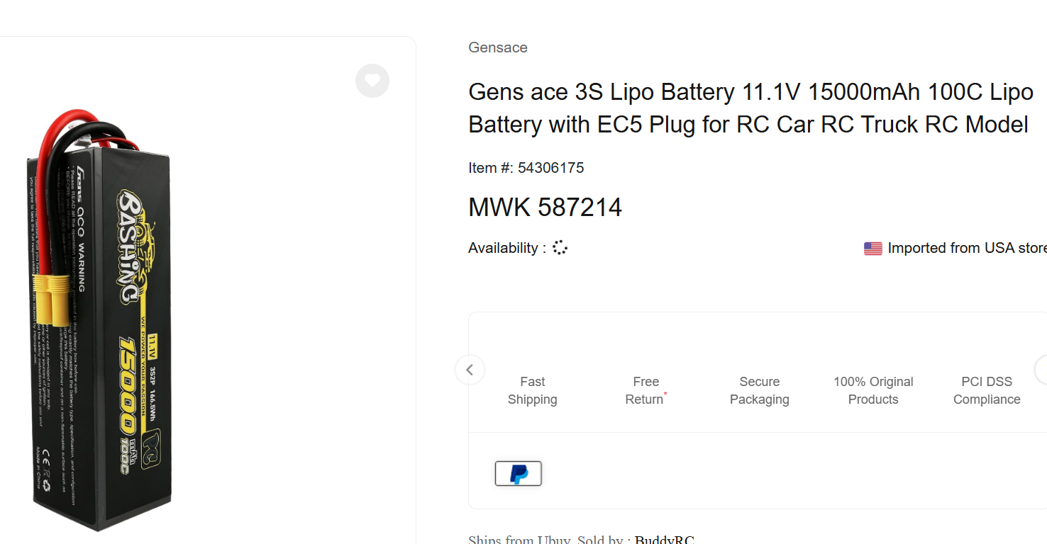
Example
Lets say we want to leave it there for 3 days
3*24 = 72 hours
72 = battery / 202.5mA
Battery = 72 * 202.5 = 14580 mAh

Slide 41
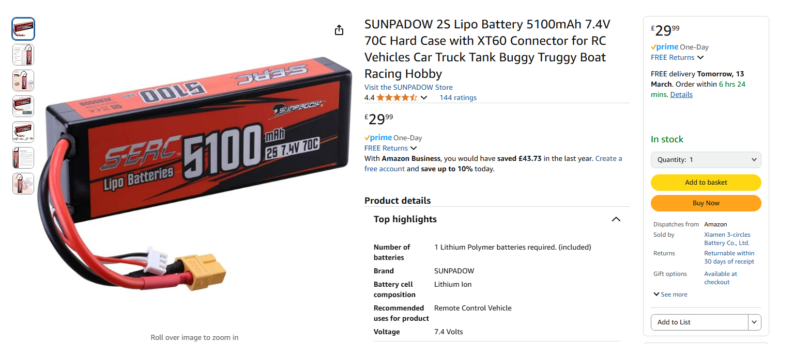
RC car batteries are a great source

Slide 42
Todays task

Slide 43
Data logging in the field
We will be taking our data logging devices into the field to gather datasets
Remember what we have covered!
Names of files
If you cannot gather metadata digitally, take a notepad

Slide 44
Where we will be going
We will be going out and taking our breadboard assembled dataloggers. We will then gather data that is appropriate to our experiment, but try stick together so we can help.

Slide 45
What to do now
Get an electronics kit and construct your device
Use at least two sensors in your datalogger (or use your phones for making image datasets)
Remember to remember which recording is which - label your data!

